Slide 1
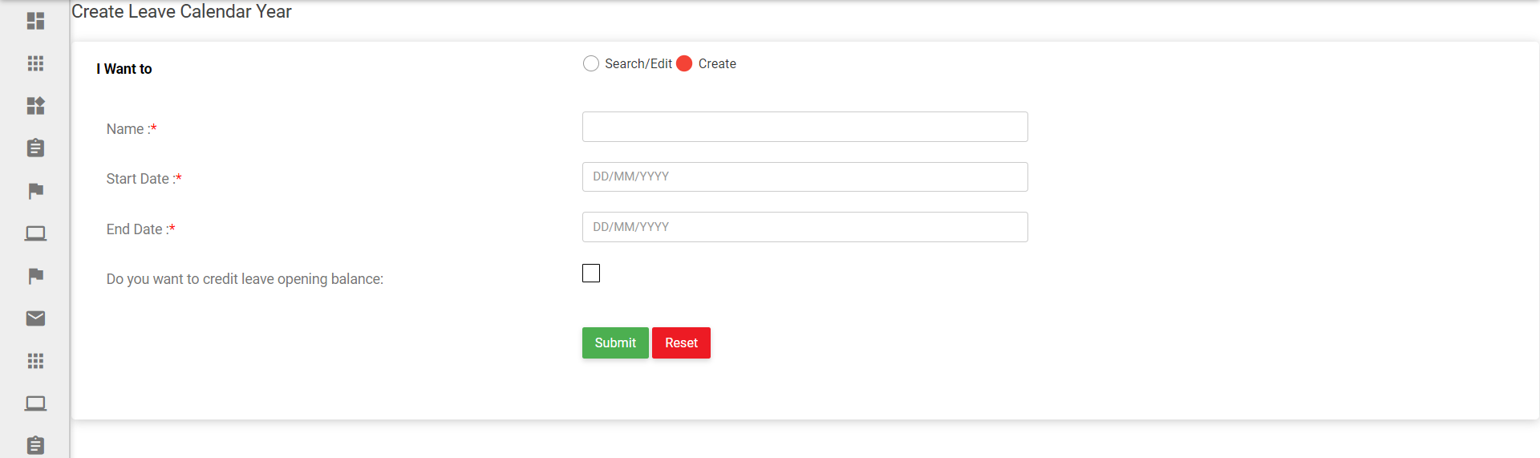
Admin Page - Create Leave Year

Slide 2
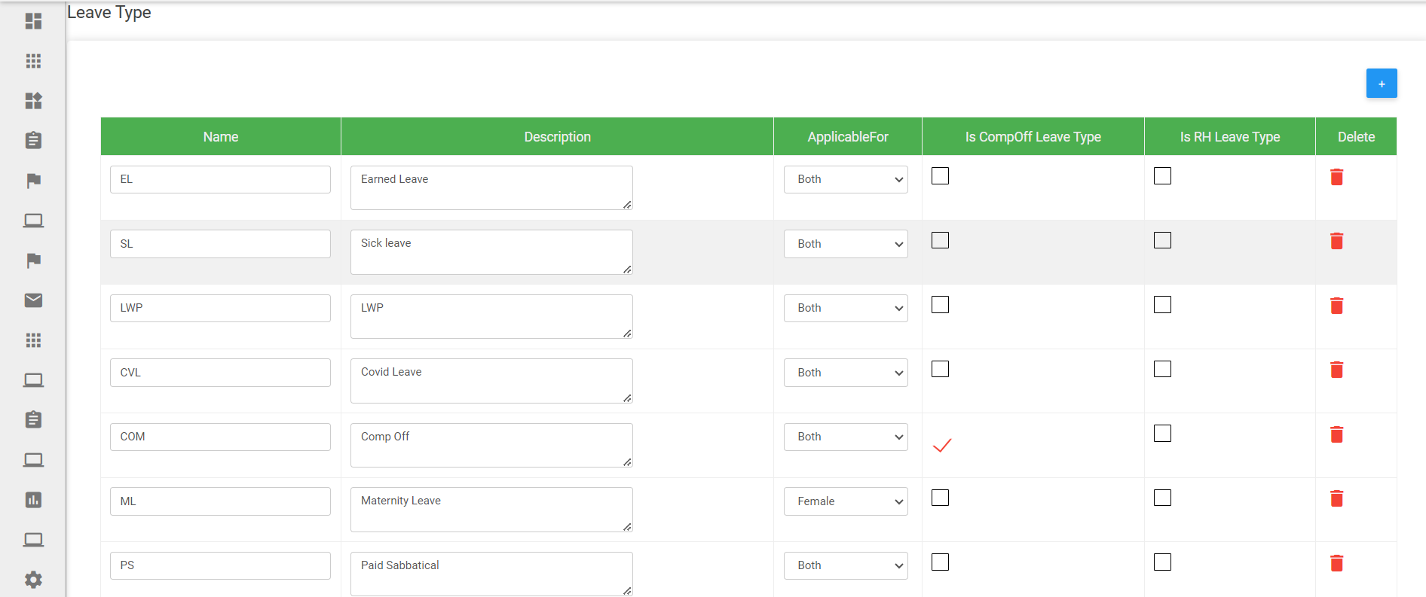
Admin Page - Create Leave Type
* Applicable For – Male / Female / Both

Slide 3
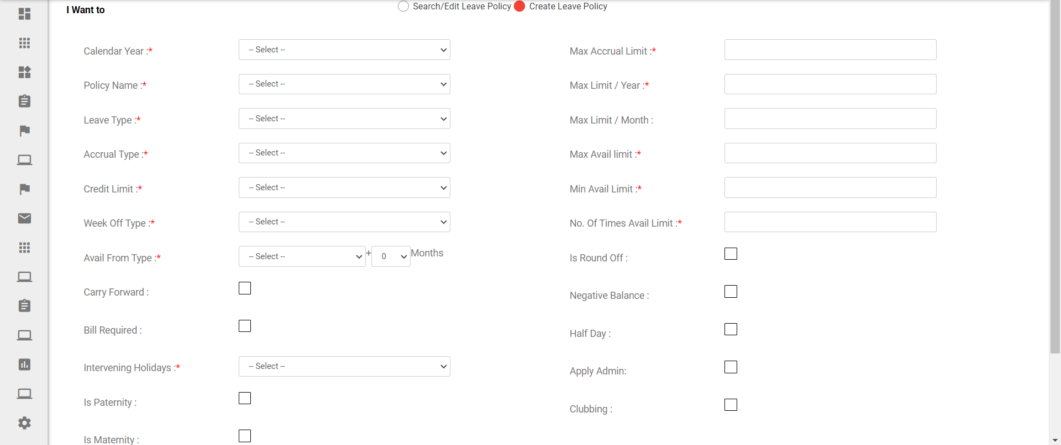
Admin Page - Create Leave Attributes (Ref to Next Slide for Dropdown Values / Variables)

Slide 4
Create Leave Attributes (Dropdown Values / Variables)
Accrual Type
Monthly / Quarterly / Annually
Credit Limit
Advance / Earned
Week Off Type
Start / End / Both / Between / Start & Between / End & Between / Start End Between / None)
Avail from Type
Date of Joining / Date of Confirmation
Intervening Holidays
Start / End / Both / Between / Start & Between / End & Between / Start End Between / None)

Slide 5
Create Leave Attributes (Dropdown Values / Variables for “Comp Off”)
Applicability
Week Offs / Holidays / Work-Days / All (Multiple Checkboxes)
Stay Hour Eligibility
Week Offs / Holidays (Multiple Checkboxes)
Less than ………….. Hours – None
Up to ………….. Hours – Half Day
More than ………….. Hours – Full Day
Work-Days (Multiple Checkboxes)
Less than ………….. Hours – None
Up to ………….. Hours – Half Day
More than ………….. Hours – Full Day
Apply Limit
Within ……….. Days
Avail / Expiry Limit
Within ……….. Days

Slide 6
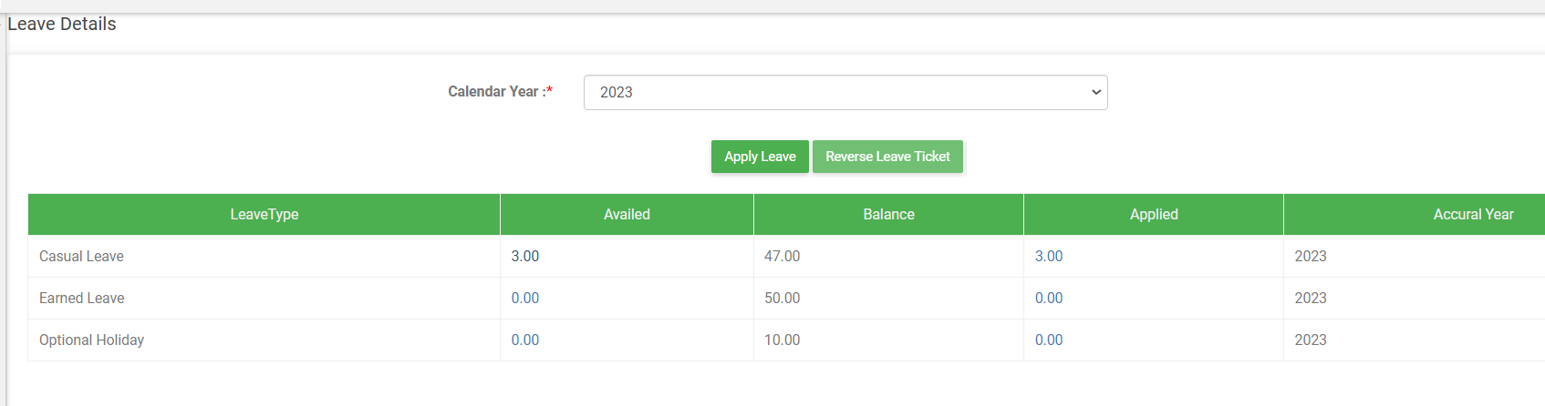
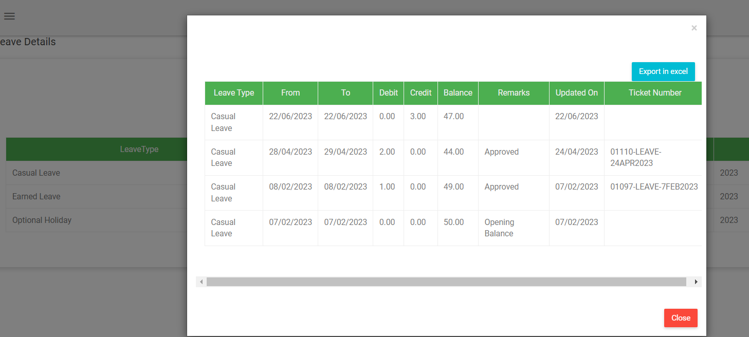
Emp. View – Leave Page (With Pop Up on Availed / Applied Links)

Slide 7
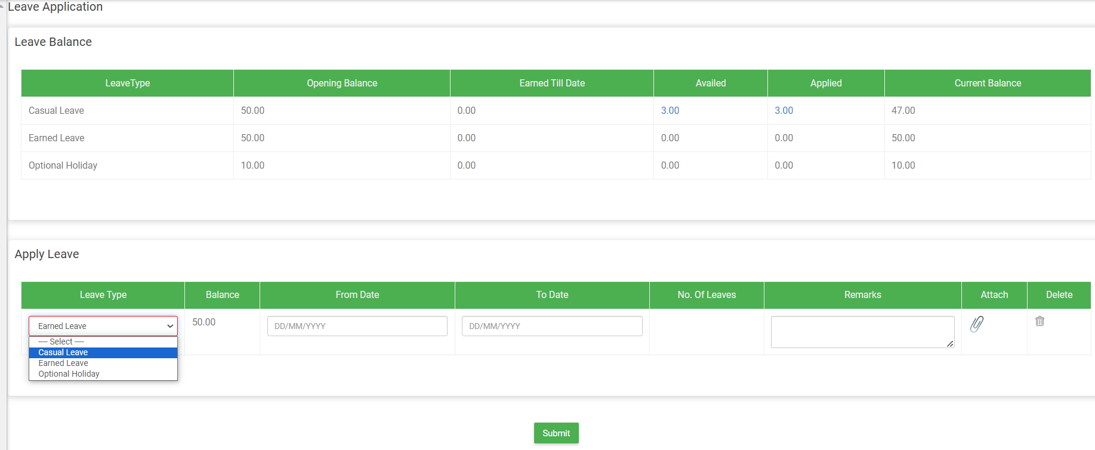
Emp. View – Apply Leave

Slide 8
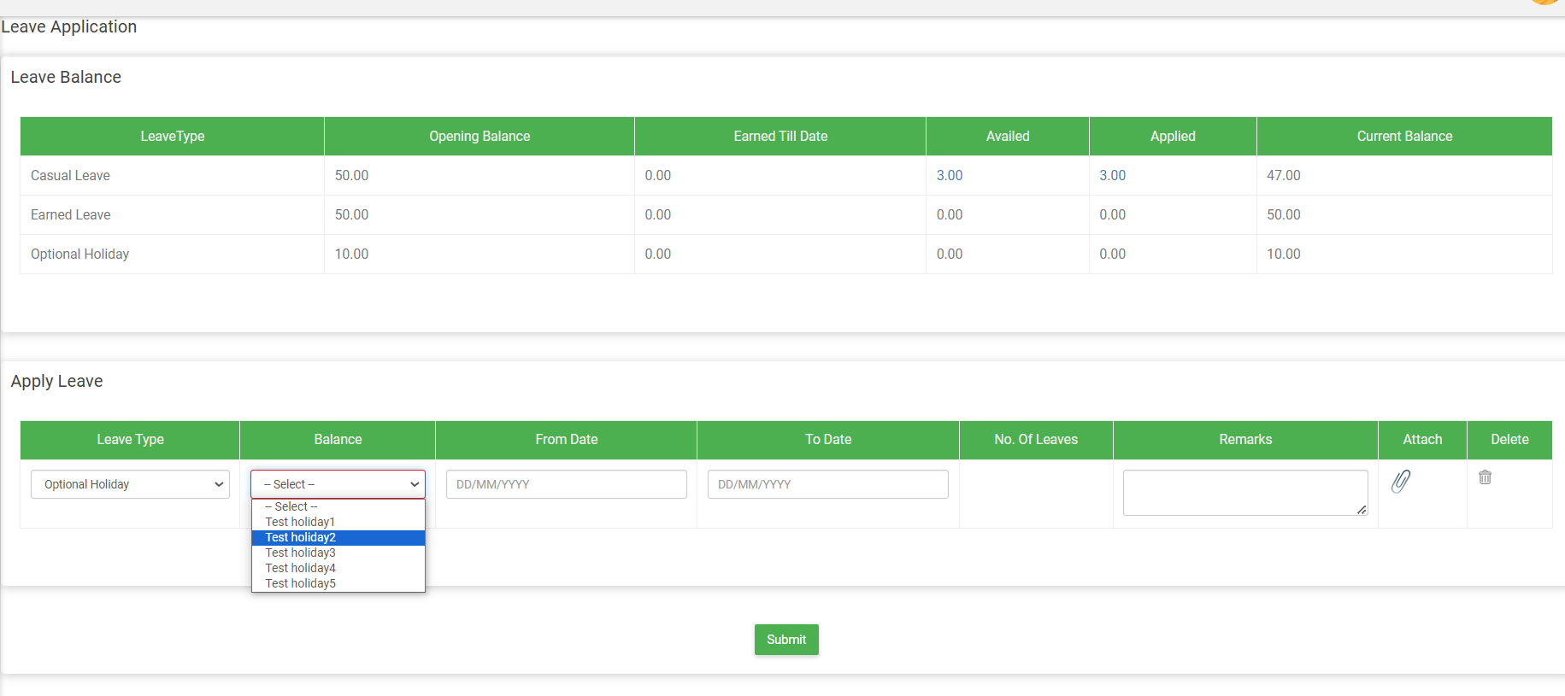
Emp. View – Apply Leave (Optional Holiday)

Slide 9
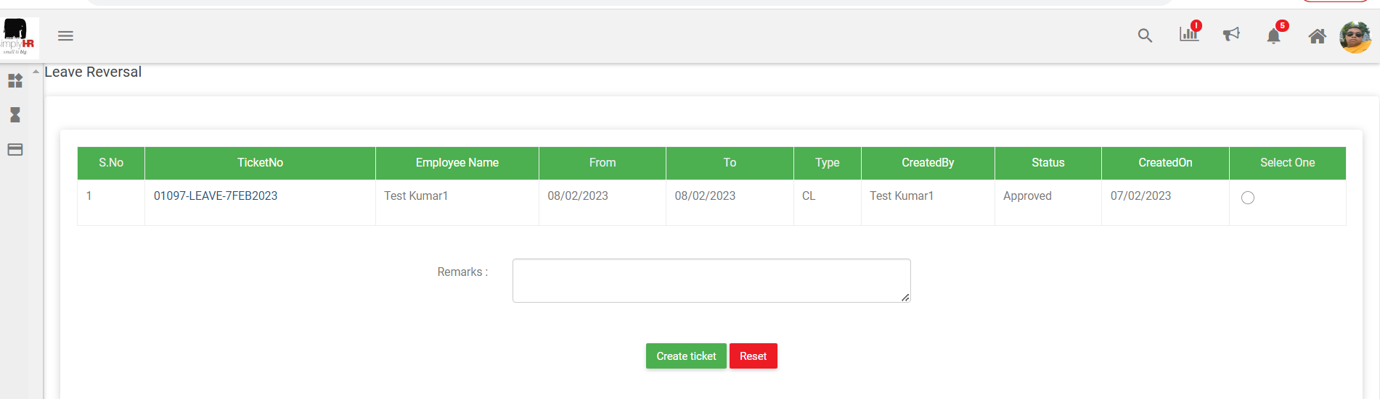
Emp. View – Reverse Leave

Slide 10
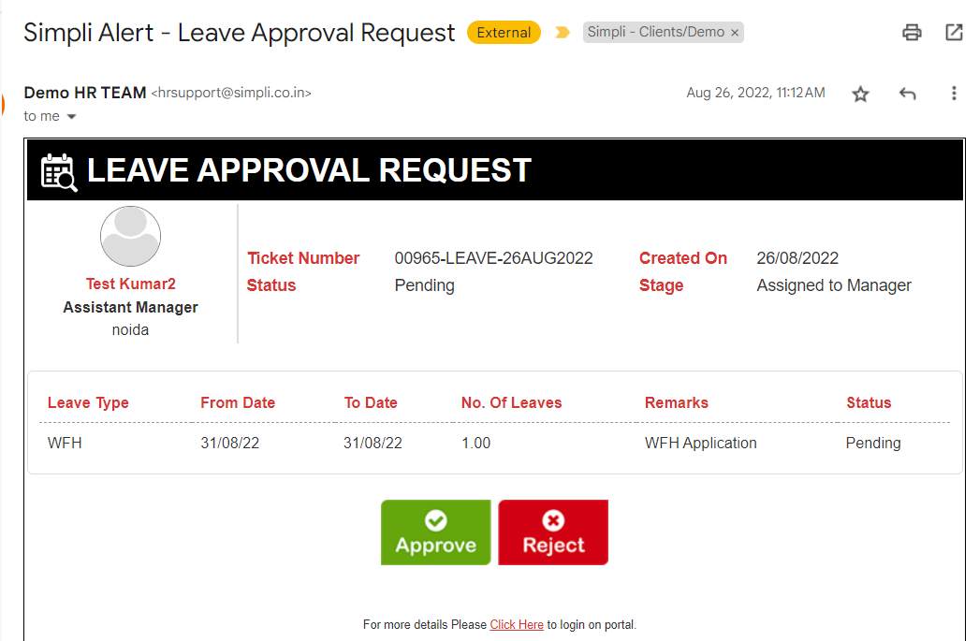
Sample of Leave Ticket on Email (HTML)

